Slide 1
GaitVis
CS 529 - Visual Data Science
Kazi Shahrukh Omar
Sajal Kherde
Soham Pradhan December 1st, 2022

Slide 2
Project Info
Motivation
Differentiate gait characteristics for:
stroke patients
healthy adults
Correlate gait characteristics to recovery
Patterns help transform rehabilitation strategies
Allow analysis of single patient trial
Understand outliers

Slide 3
Project Info
Collaborators
Dr. Tanvi Bhatt
Professor - Department of Physical Therapy, UIC
Dr. Shuaijie Wang
Research Assistant Professor - Department of Physical Therapy, UIC
Dr. Fabio Miranda
Assistant Professor - Department of Computer Science, UIC

Slide 4
Project Info
VDS Challenges
Scalability
Visual Encoding
Custom Analysis

Slide 5
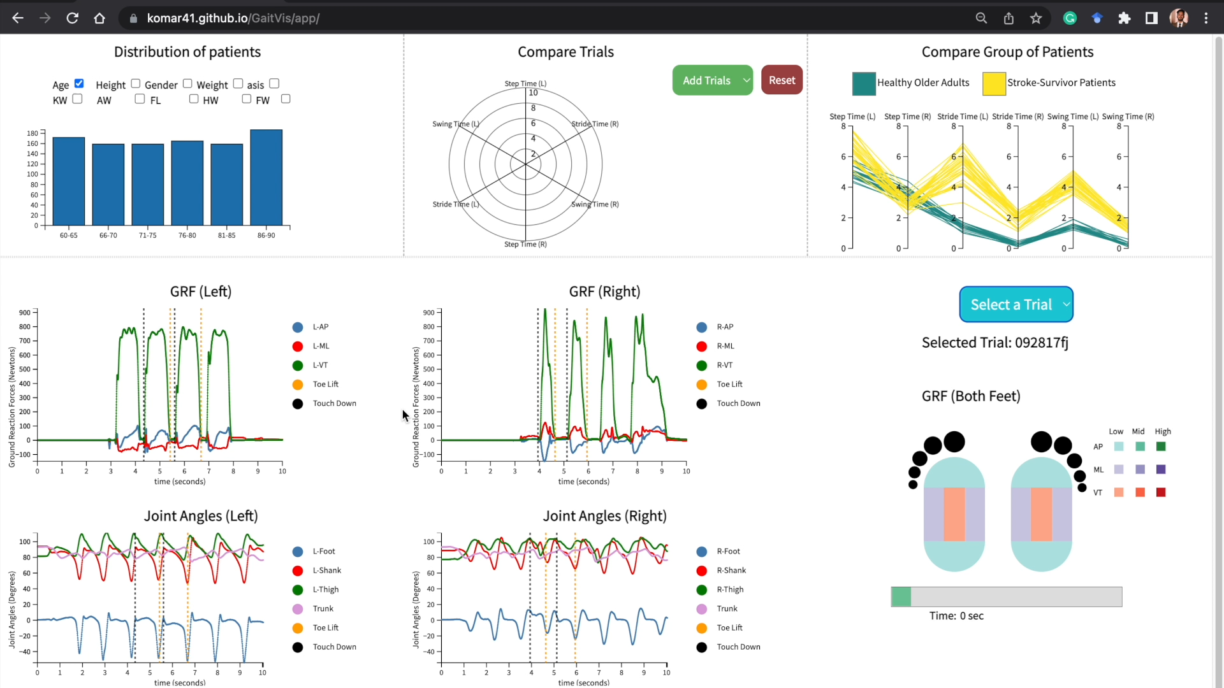

Slide 6
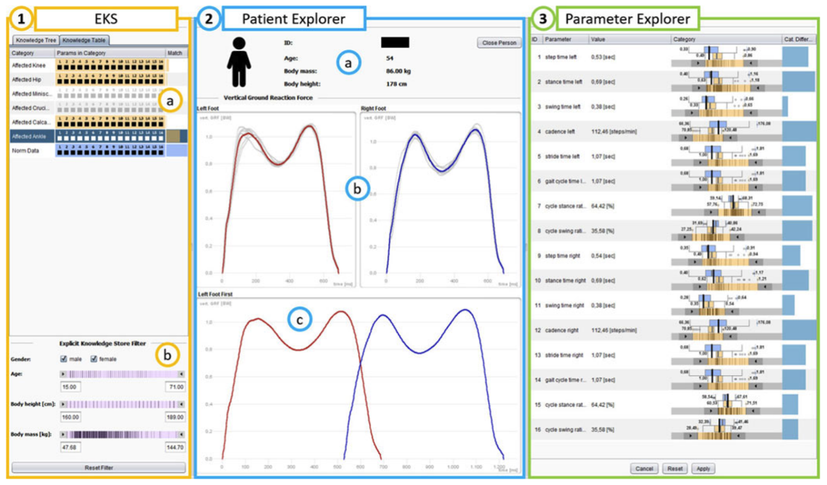
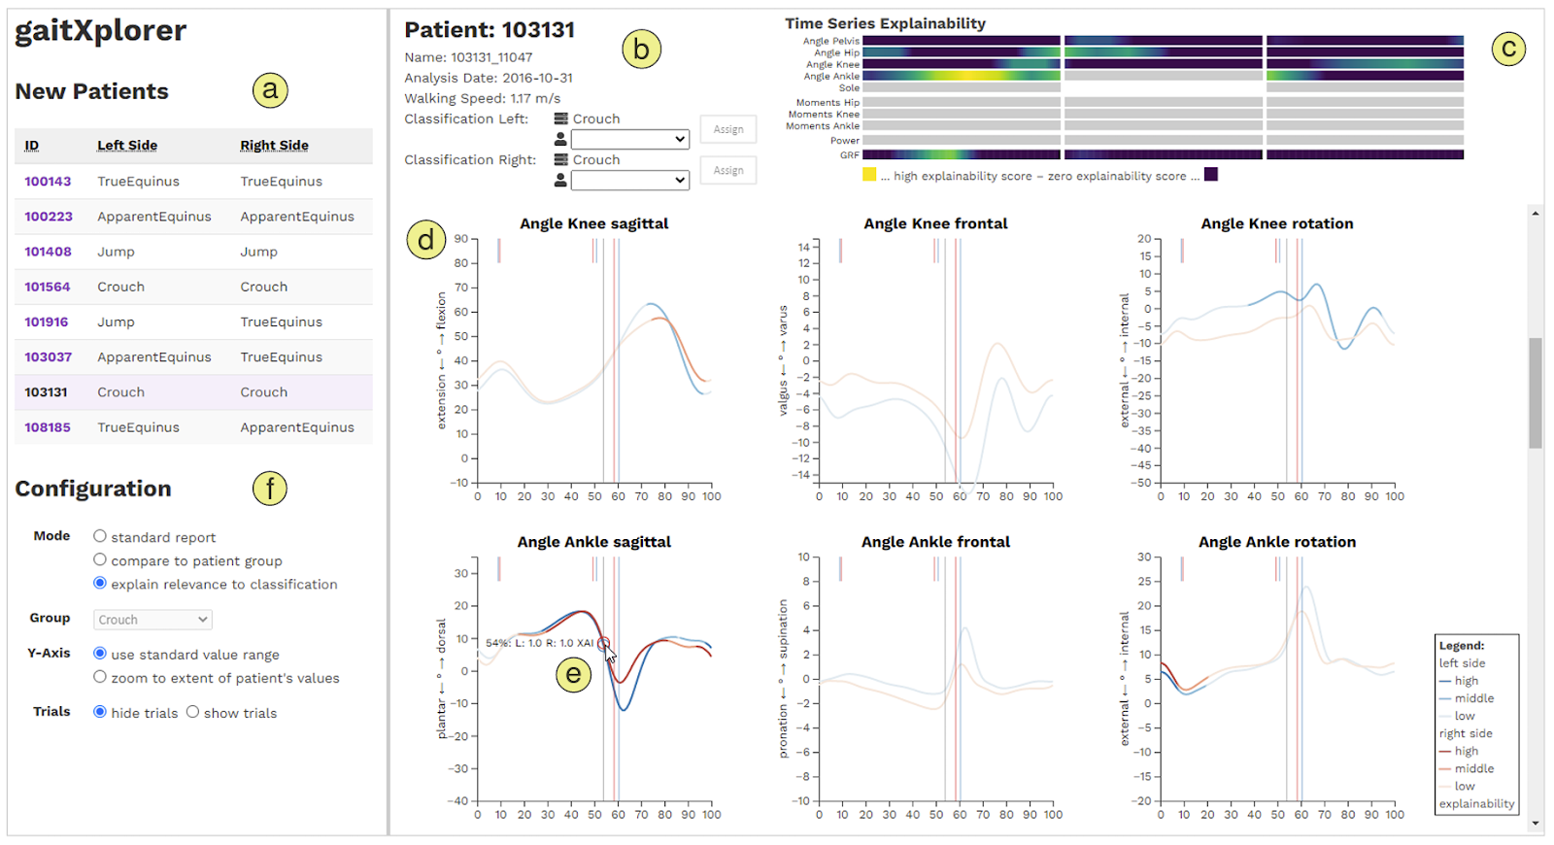
State of the Art
KAVAGait
gaitXplorer
M. Wagner, D. Slijepcevic, B. Horsak, A. Rind, M. Zeppelzauer, and W. Aigner, ‘‘KAVAGait: Knowledge-assisted visual analytics for clinical gait analysis,’’ IEEE Trans. Vis. Comput. Graphics, vol. 25, no. 3, pp. 1528–1542, Feb. 2018.
A. Rind , D. Slijepčević , M. Zeppelzauer, F. Unglaube , A. Kranzl, B. Horsak., ‘‘Trustworthy Visual Analytics in Clinical Gait Analysis: A Case Study for Patients with Cerebral Palsy’’ IEEE Workshop on TRust and EXpertise in Visual Analytics, 2022. (To be published)
Notes:
Coming on to the state of the art models, KAVAGait visualizes complex gait but only allows to look at one patient’s data at a time.
gaitXplorer system visualizes gait classification of time series gait data.
Both of these system limits comparative analysis between multiple trials or group of trials which is the primary goal of our project.

Slide 7
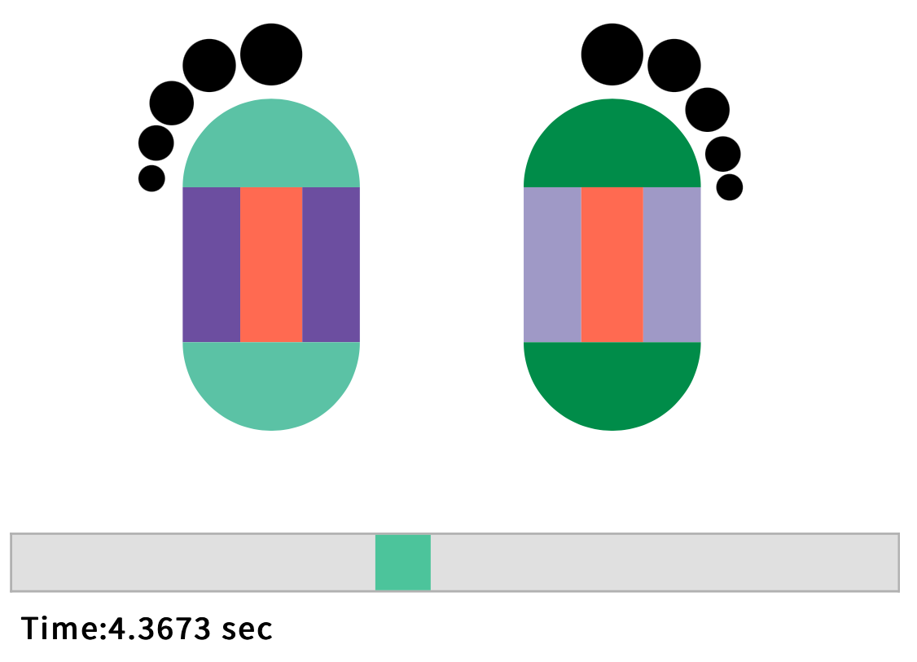
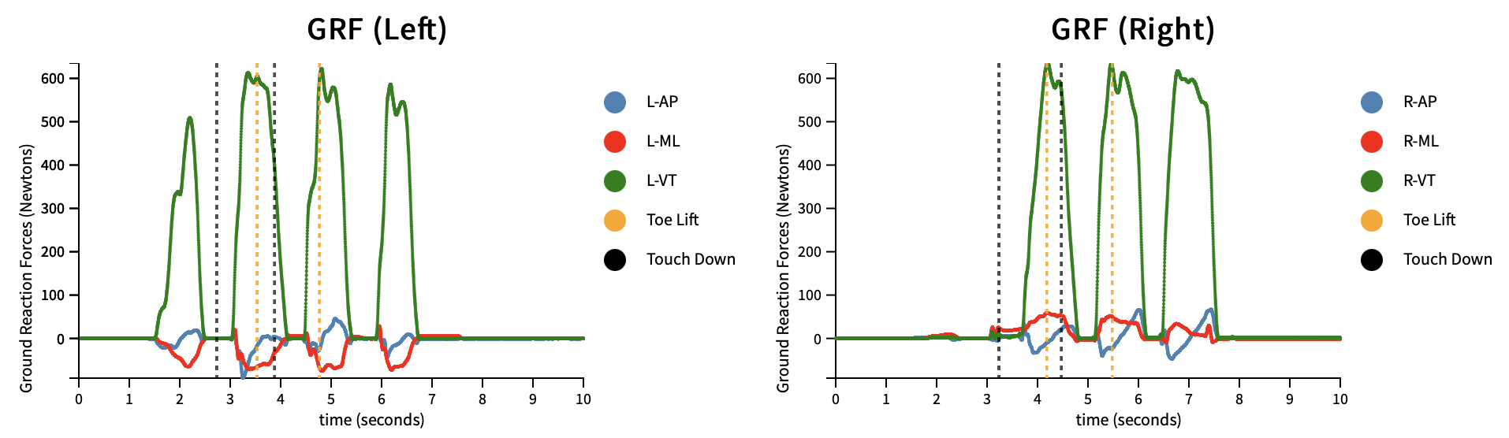
Novel Visualization
Ground Reaction Forces
Notes:
Line chart helps us see the values of GRF for both the feet but we are not able to compare the values of 2 feet. In order to better understand about the comparison and know the intensities over time, we designed a novel encoding that changes the colors over time.

Slide 8
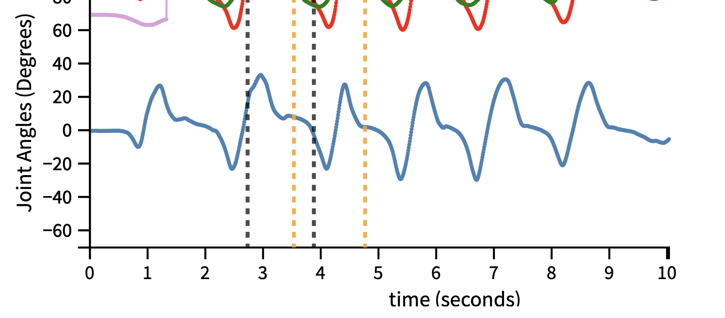
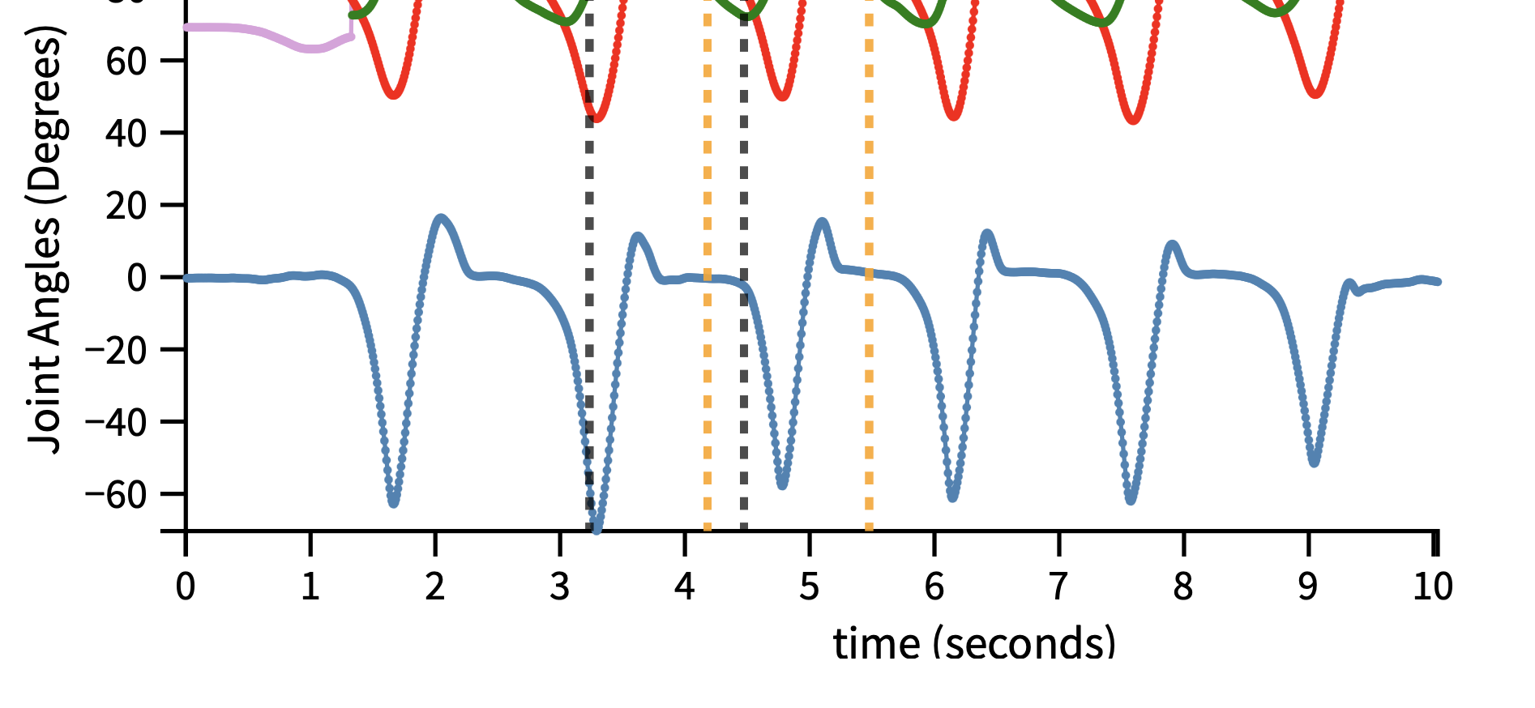
Results
Interesting Findings
Joint Angles (Left Foot)
Joint Angles (Right Foot)
Notes:
Joint angles in left foot is lower than joint angles in right foot and the variation in them.

Slide 9
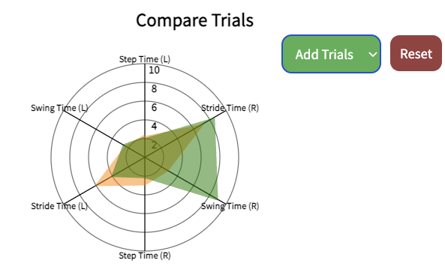
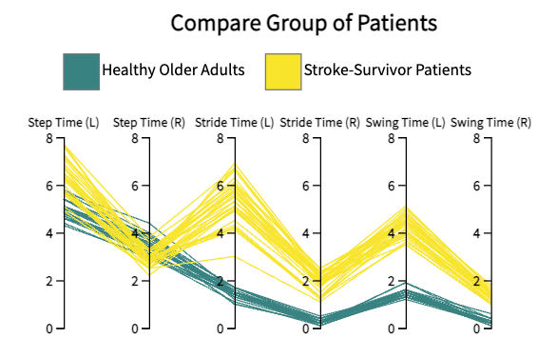
Results
Interesting Findings
Spider Plot
Parallel Coordinate Plot

Slide 10
Results
Experts’ Feedback
Impressed with the interface’s performance capabilities
comparing multiple trials
two different groups of trials
Appreciated the novel encoding
Requires brushing and linking the charts
Suggested an option to choose between multi-patient and single-patient view
Notes:
Believes the project is valuable for gait analytics tasks

Slide 11
Conclusion
Allows analysis of gait comparison
Opportunity for better analysis using more data
Help transform rehabilitation strategies
Collaboration efforts resulted in a viable product

